Slide 1

Business Problem
Augment the hospitality business by
Examining the high cancellation rate,
Exploring untapped business opportunities,
Finding existing pitfalls & suggesting suitable measures

Slide 2
Null Values Handling NaNs
Those Nans recognized by numpy
Country col : Imputed by mode of country.
Agent & Company columns : Replaced by NA(Not Applicable)
Columns | Percentage Null Values
Country | 0.51%
Agent | 14%
Company | 94%
Not recognized by np/Inconsistent Data
dtype of Arrival_Date was converted to datetime using try -except block.
No inconsistent data is present
Such Inconsistent Data are found out by checking whether the dtype of the column is suitable or not. Ex ? In arrival date col

Slide 3
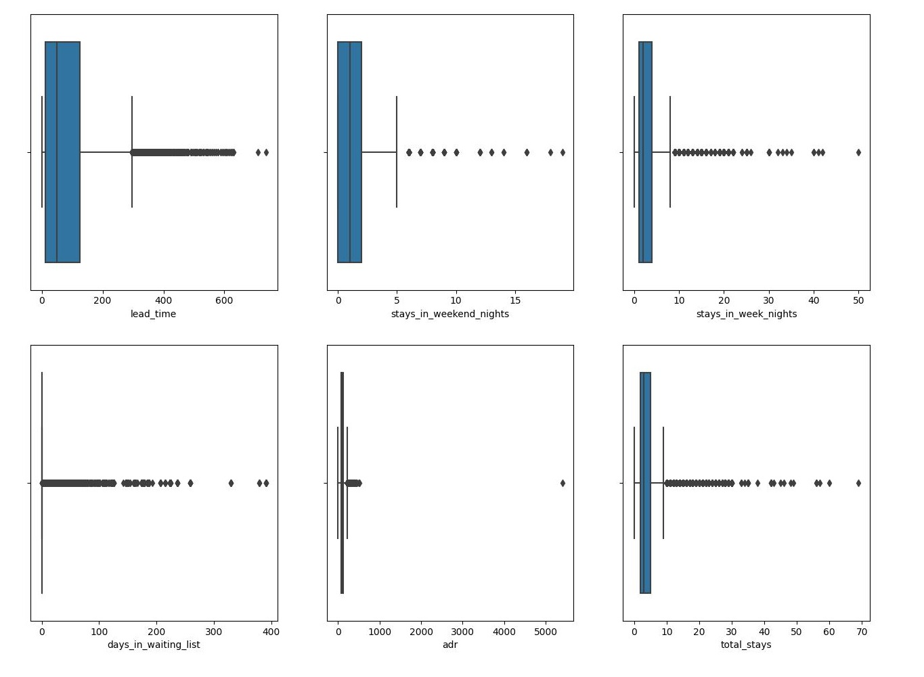
Outlier Detection
['lead_time’
,'stays_in_weekend_nights’,
'stays_in_week_nights’,
'days_in_waiting_list','adr’,
‘total_stays’
']

Slide 4
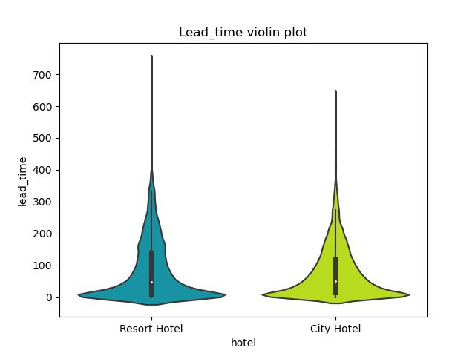
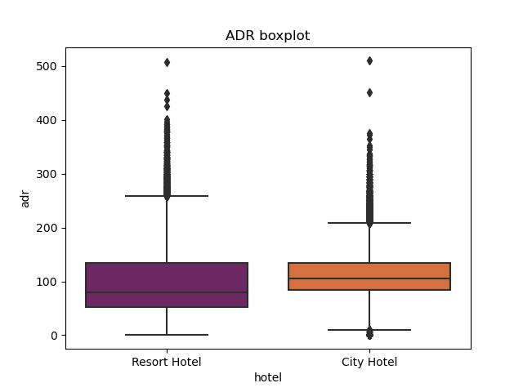
Outlier Treatment
Observations
In Europe , people plan their vaccation 6 months before.
60 % of bookings before 365 days are realized. Therefore, such rows are not dropped.
Later it is proved that higher the lead time greater are the chances of cancellation
Observations
in City Hotel ADR=0 is ASSUMED to be promotional discount, therefore not dropped.
2. ADR -6 & 5000 was dropped.

Slide 5

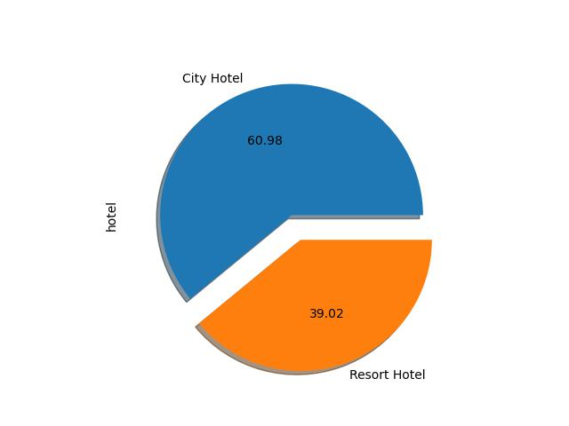
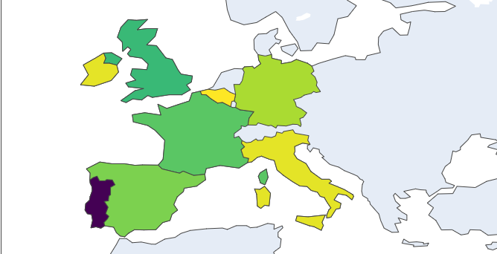
Tops & Bottoms – of various Columns
Hotel-type-wise Distribution
Top Country – 1. Portugal
2. UK
Untapped business opportunity
Overseas business could be harnessed by
1. Leveraging digital marketing.
2. Listing on local hotel booking apps of the overseas country

Slide 6
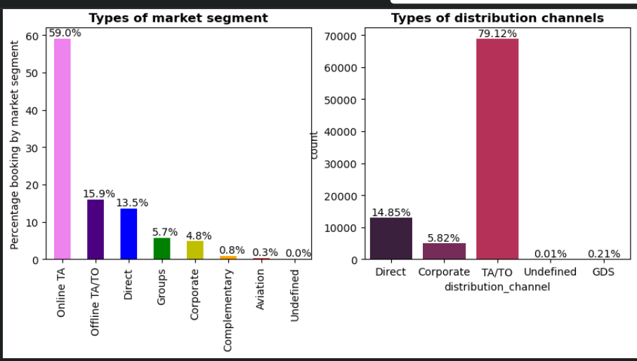
Top mkt segment share
TAs share has already reached saturation levels.
Untapped business opportunity
Incorporate Corporate & Aviation companies as customers, as their share in the mkt segment is less than 5%
.Steps like –
1. entering into half yearly contracts
2. Corporate group trip stays
3. employee family holiday packages etc

Slide 7
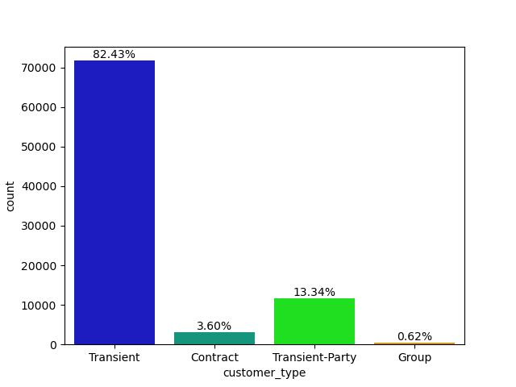
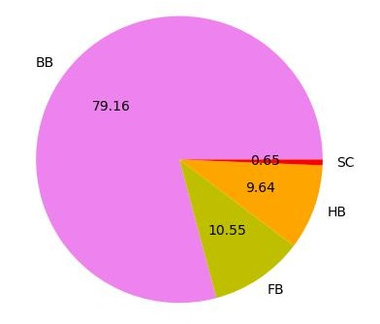
Top Meal type – Bed & Breakfast
Top Customer Type -- Transient
Recommendation/s
1. 98% customers opt for the meal , Due to high demand of meal, its prices can be increased
Recommendation
Tap the share of Contract customers by incorporating aviation sector & corporates.

Slide 8
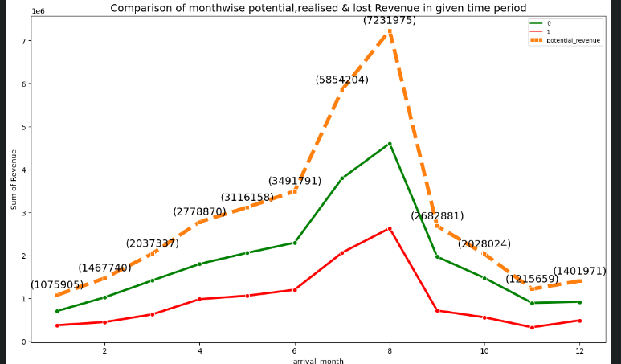
Cancellations – A Major Loss to Revenue
1. 33% of revenue or 1,14,51,509 Euros revenue loss incurred due to cancellations in given time period.

Slide 9
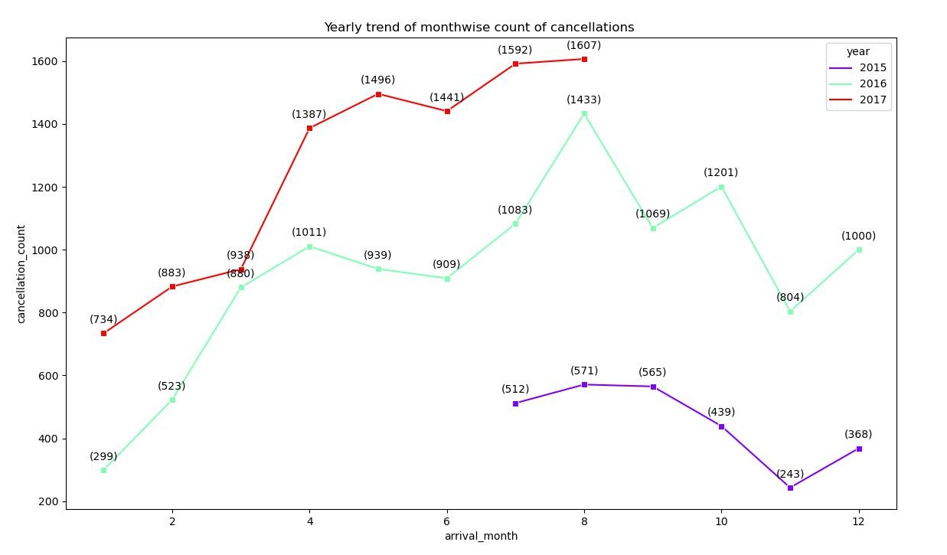
Yearly Trend of Monthwise cancellation count

Slide 10
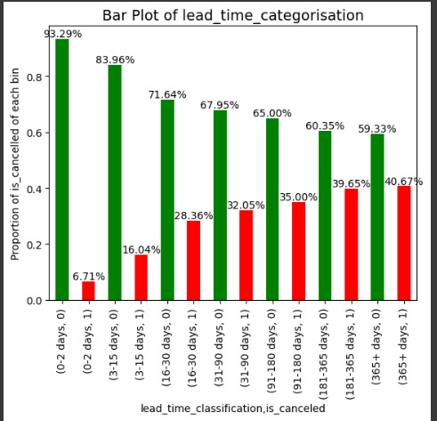
Leadtime vs Cancellations
Observations
As the lead time increases, the cancellation percentage also increases.
For lead time greater than 15 days cancellation is greater than 30%
Recommendation/s
Disallow advance booking of more than 15 days.

Slide 11
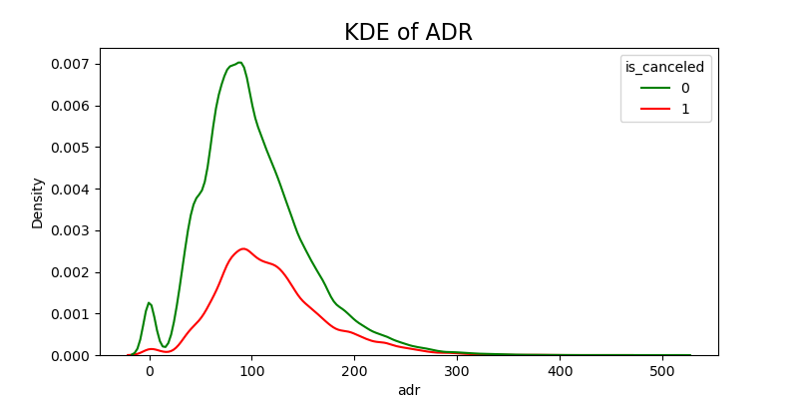
ADR vs Cancellations
Hypothesis –
High ADR(price) leads to increased cancellations
Observation –
1. Both green and red plot have highest probability density near ADR 100.
2. When ADR is 0 ,then also there are cancellations
Conclusion
Our prices are competitive

Slide 12
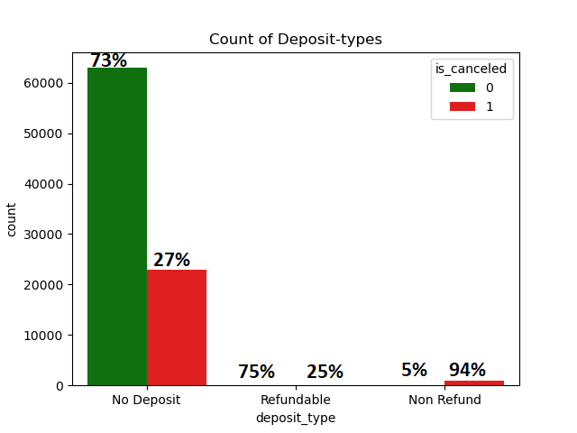
Deposit types vs Cancellations
Hypothesis—
Lower cancellation rates in case of non refundable advance bookings.
Observations
1. Non refundable deposits have 95% cancellation rate. It has not been able to stop cancellations
2. Since non refundable bookings are also less in number ,it implies people hesitate to pay advance payments.
Recommendation/s
1. Do way with non refundable bookings

Slide 13
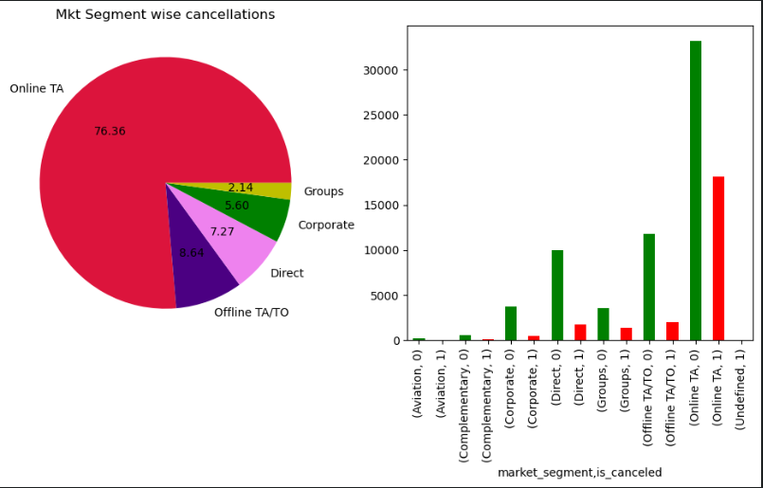
Mkt segment VS Cancellations
Online Tas & Groups -- For every 100 tickets booked ,35 are cancelled. But, they outperform in bringing business with more than 30k non-cancelled tickets
3. For rest segment, cancellations are within 15% threshold.
4. From pie plot,Out of total cancellations ,75% come from Online TAs
Recommendation/s
1.Overbook the hotel than the occupancy using a suitable model.

Slide 14
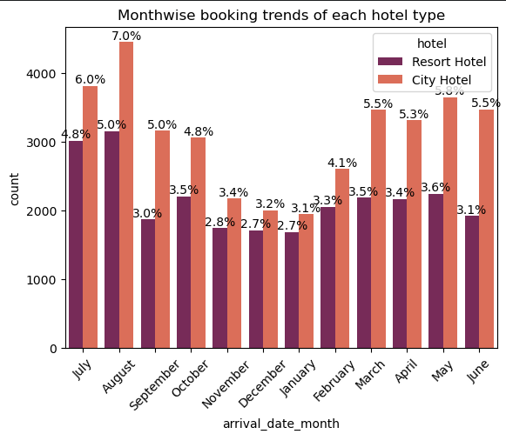
Cumulative Month-wise booking trends of each hotel type
Observations
1. July, Aug are peak business months
2. Dec, Jan are the lean business seasons
Recommendation/s
Dynamic Pricing can be introduced in peak booking months Aug ,July
Discounts can be given in Jan & other low booking months to increase occupancy

Slide 15
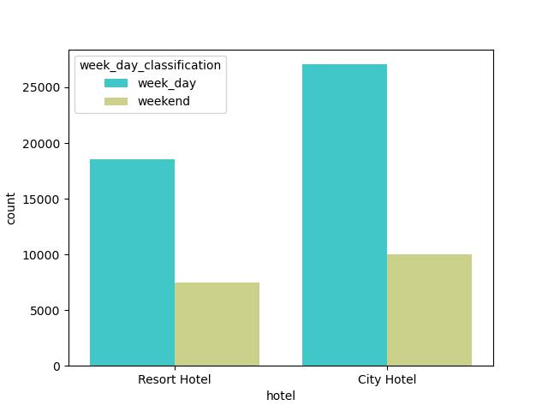
Week day or weekend :Occupancy & ADR Trends
Observation
72% bookings happen in 5 weekdays implying 14.2 % per day( 72/5) in both hotel types
28% bookings happen on weekend ie 2 days14% per day
Same booking percentage each day for both the hotels.
Same ADR for both week days & weekend days

Slide 16
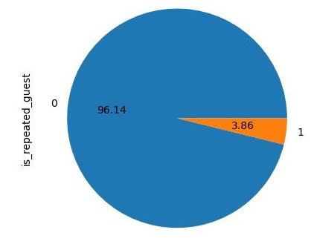
Low Customer Retention
Observation
Only 4% repeated customers.
Recommendation/s
Get a feedback form filled-- Find possible reasons of low repeatability. Work on those suggestions.
Start loyalty cards scheme , discount on subsequent visits.
Need to focus on customer retention as it is more economical than customer acquisition

Slide 17
Cancelling the cancellations
Disallow advance booking of greater than 15 days
Introduce Dynamic pricing in peak business months of July & August. Discounts in lean business season of Dec & Jan
Overbook hotels by deploying a suitable model to buffer against cancellations

Slide 18
Untapped business opportunities--
Incorporate Corporate & Aviation companies as customers, employee
Increase customer retention Measures like loyalty cards , cashbacks ,discounted next visits etc can be taken
Tap overseas market --.Leverage digital marketing , list our hotel on the local hotel booking apps of thhe respective overseas country
Existing Pitfalls
End Non refundable advance bookings-- Non refundable deposits have 95% cancellation rate.It has not been able to stop cancellations .Since non refundable bookings are also less in number ,it implies people hesitate to pay advance payments.

Slide 19
Thank You Presented By Lakshay nandwani Cohort Bali

